Slide 1



Content
Introduction
Group Details
Motivation
Applications
Reference
Data Set used
Use Cases
Conclusion
Peer Evaluation

Slide 2

Stock Price Prediction
The stock market is a complex and dynamic system, offering both opportunities and challenges for investors.
Due to the high profit of the stock market, it is one of the most popular investments.

Slide 3

Group Details
Group Members | Role | Group
Abhinav Kumar | Algorithms Proposed | M.E. CSE - 1
Anurag Karmakar | Data Provider | M.E. CSE - 1
Atul Garg | Accumulated Resources | M.E. CSE - 1
Ayush Susheel | Implementation | M.E. CSE - 1

Slide 4

Motivation
The future price of a stock is the main motivation behind the stock price prediction.
Many user’s are not aware of proper entry & exit points

Slide 5

Application Area’s (Domain Specific)
Industry
Business
Finance
Market Forecasting
Insurance company
Notes:
Investment Portfolio Management
Environmental science.
Government Agency
Algorithmic Trading

Slide 6

Reference
Stock Price Prediction Using Machine Learning By 18CP80:Maithili Patel :- (Reference )
Objective :- Calculate Yeild Significant Profit
Dataset Used :- Csv format ( Link )
Algorithms Used :- CNN, LSTM, Hybrid Approach
Results :- Hybrid Model should be preferred.
Limitations :- Age of Data (2000 - 2019)

Slide 7
Other’s
Stock Market Analysis using Supervised Machine Learning
(Linear regression)
Link
Stock Market Prediction Using Machine Learning
(LSTM)
Link

Slide 8

Type of data involved, Data Sources
Kaggle :- Link
Google DataSet :- Link
CSV Format

Slide 9
Features of DataSet
Features
Symbol
Open
Volume
AdjClose
AdjHigh
AdjOpen
High,
Low,
Close Prices

Slide 10
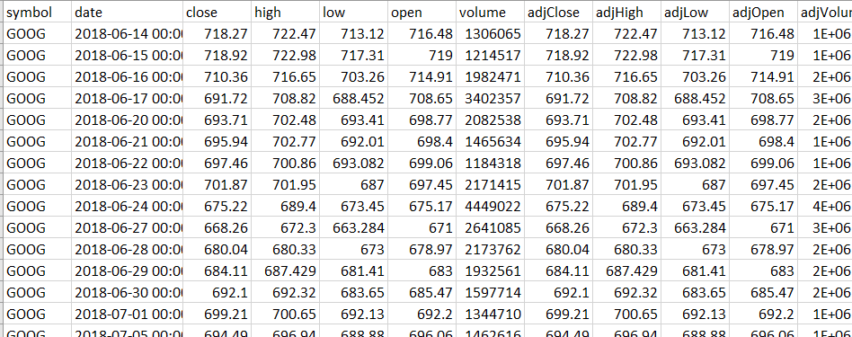
DataSet

Slide 11



Relevant use cases
Financial markets
Weather Forecasting
Forecasting the prices of Bitcoin

Slide 12
Conclusion
1
Embracing Innovation
2
Responsible Development
Notes:
Continuous advancements in machine learning and data science will further enhance our ability to navigate the complexities of the stock market.
As these technologies evolve, it is crucial to address ethical considerations and ensure the responsible use of predictive models.

Slide 13
Quiz
1
Which is the number one stock exchange in the world?
Notes:
NYC Stock Exchange

Slide 14

Peer Evaluation
Param’s | Application | Group Details | Data Source | Use Case | Total
Team “A.”

Slide 15
THANKYOU
Notes:
NYC Stock Exchange

